Slide 1
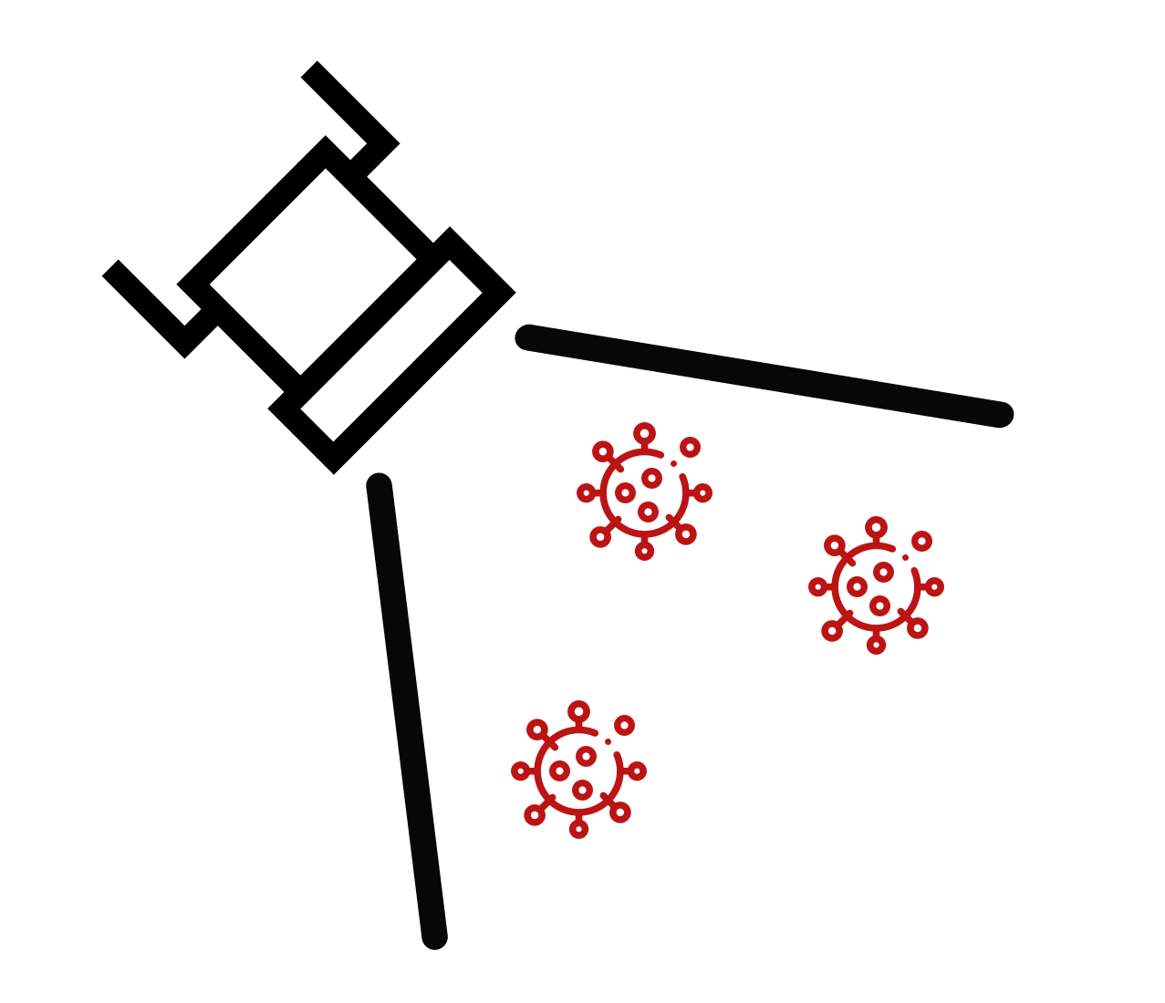
FloodLAMP
Biotechnologies, PBC
Delivering the testing our world needs
For COVID-19 and beyond
Randy True, Founder and CEO | randy@floodlamp.bio

Slide 2
Addressing Current Vulnerabilities
Antigen Tests are at Risk of Failure with New Variants
Preliminary observational reports of antigen test failures in multiple outbreaks (BinaxNOW)
Even if current antigen tests prove to detect Omicron, we're at risk of that not being the case with the next VOC
Multi-Gene Molecular Tests are Resilient to New Variants
Our test combines primer sets for 3 genes: ORF1ab, N2 and E1
LAMP uses 6 primers and is highly tolerant to mismatches ( see recent NEB preprint analyzing our primers)
Reagent Based Molecular Tests are Adaptable
Primers can be swapped out quickly and cheaply, with all other test components remaining the same
Primers can be produced in large volumes and distributed quickly (10's of M of reactions per production run)
FloodLAMP can deliver Prepositioned Assets
For distributed, rapid response surge capability
Our systems comprise ordinary low cost lab equipment and offer best-in-class capacity per cost
We deliver custom-designed wraparound components (digital tools, QA, training) that enable rapid scaling

Slide 3
Bypassing Typical Limitations
Not limited by CLIA labs
Non-Dx "surveillance" screening permitted by FDA and CMS but potential has not yet been realized at scale.
Huge advantage in flexibility for deployment to widely distributed bare-bones test processing sites, which minimizes turnaround time and give highly valued local control and resiliency.
Not limited by need for certified clinical lab techs
Staffing shortages in the testing field are stifling. We can bring on and train new test operators very quickly while simultaneously ensuring test safety, reliably, and traceability.
Not limited by upfront capital equipment
$2K of standard, non-proprietary equipment gives 20K/day screening capacity.
Sites can typically operate far under max capacity, and then quickly surge with addition of extra labor.
Not limited by centralized manufacturing and sole sources
Our test use standard consumables and has reagent supplier redundancy.

Slide 4
Filling a Gap in the Testing Landscape
At Home
OTC
Point of Care
Point of Need
CLIA Labs
Scaling a single test up to very high levels offers opportunities for innovation in sampling, test chemistry, and program configuration.
A "Point of Need" modality of testing is needed that combines the scalability and low cost of liquid reagent processing with the ease, flexibility and decentralized nature of POC/At-Home.
Public Health processing sites can fill the gap between CLIA labs and DIY at home tests.
Want this new capability to be additive and not cannibalize the clinical diagnostic infrastructure.
Current testing paradigms cannot stem a pandemic caused by an asymptomatically transmitted, aerosolized pathogen.

Slide 5
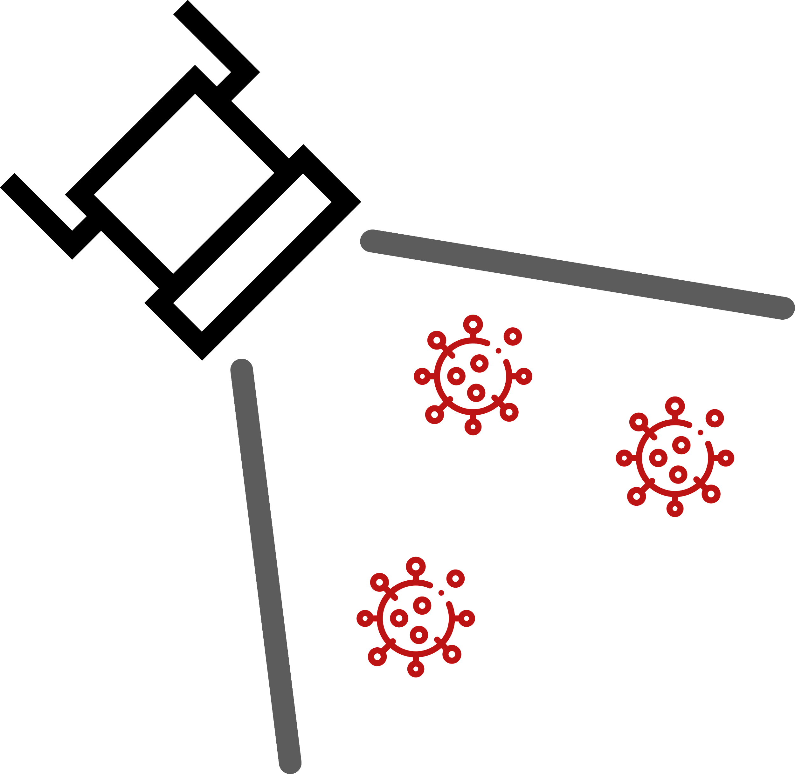
Performance in All Dimensions
Will help usher in era of at-home concierge diagnostics but simply too constrained by manufacturing and too expensive for public health screening.
People want higher confidence for both positive and negative results.
Rapid Turnaround Time
< 2 hrs sample to answer
High upfront capital cost for PCR instruments limit replicability. These 2 tests have potential to drive down PCR costs.
Antigen Test Strips
Rapid Molecular Cartridges
Local
Fast
Cheap
Molecular
Flexible
Resilient
FloodLAMP QuickColorTM
Low Cost
< $5 per person
Good Sensitivity
Detects Pre-Infectious Asymptomatics
Long turnaround renders it unsuitable for large scale screening - schools and workplaces need to know quickly if someone is infected.
SalivaDirectTM & FloodLAMP Pooled Swab PCR
Clinical Lab Purified PCR

Slide 6
FLOODLAMP PLATFORM
Applications
Products
COVID Response
Emerging Threats
(Pandemic Prep)
TB
Zikka
Influenza
STD's
Cancer
All-in
Test Kits
Reagent
Test Kits
Collection Kits
Standard Equipment
Standard Consumables
PHYSICAL
Core
Modules
Sample Processing Sites (Labs)
DIGITAL
App
Admin Portal
Training Program
Quality Management System
Service, Support,
Consulting
Network
EMS & Municipalities
Schools and Businesses
U.S. Federal Agencies (BARDA, ASPR, CDC, DoD, FEMA)
International Governments
Testing Program Management

Slide 7
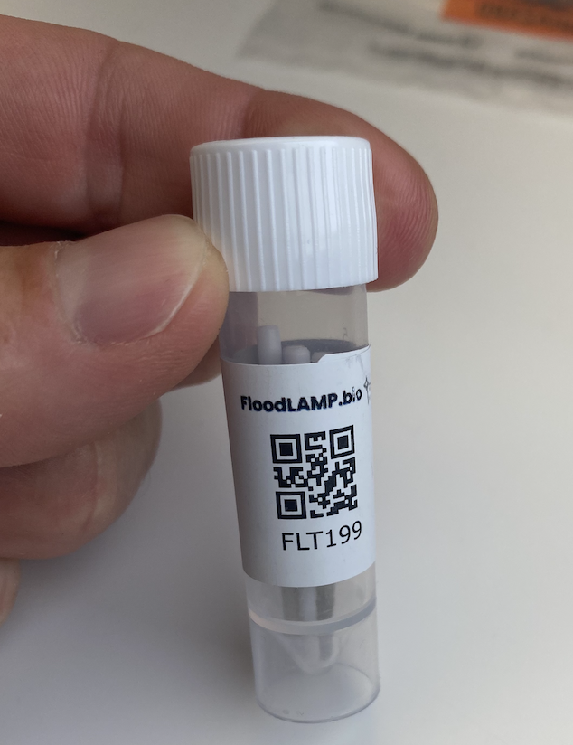
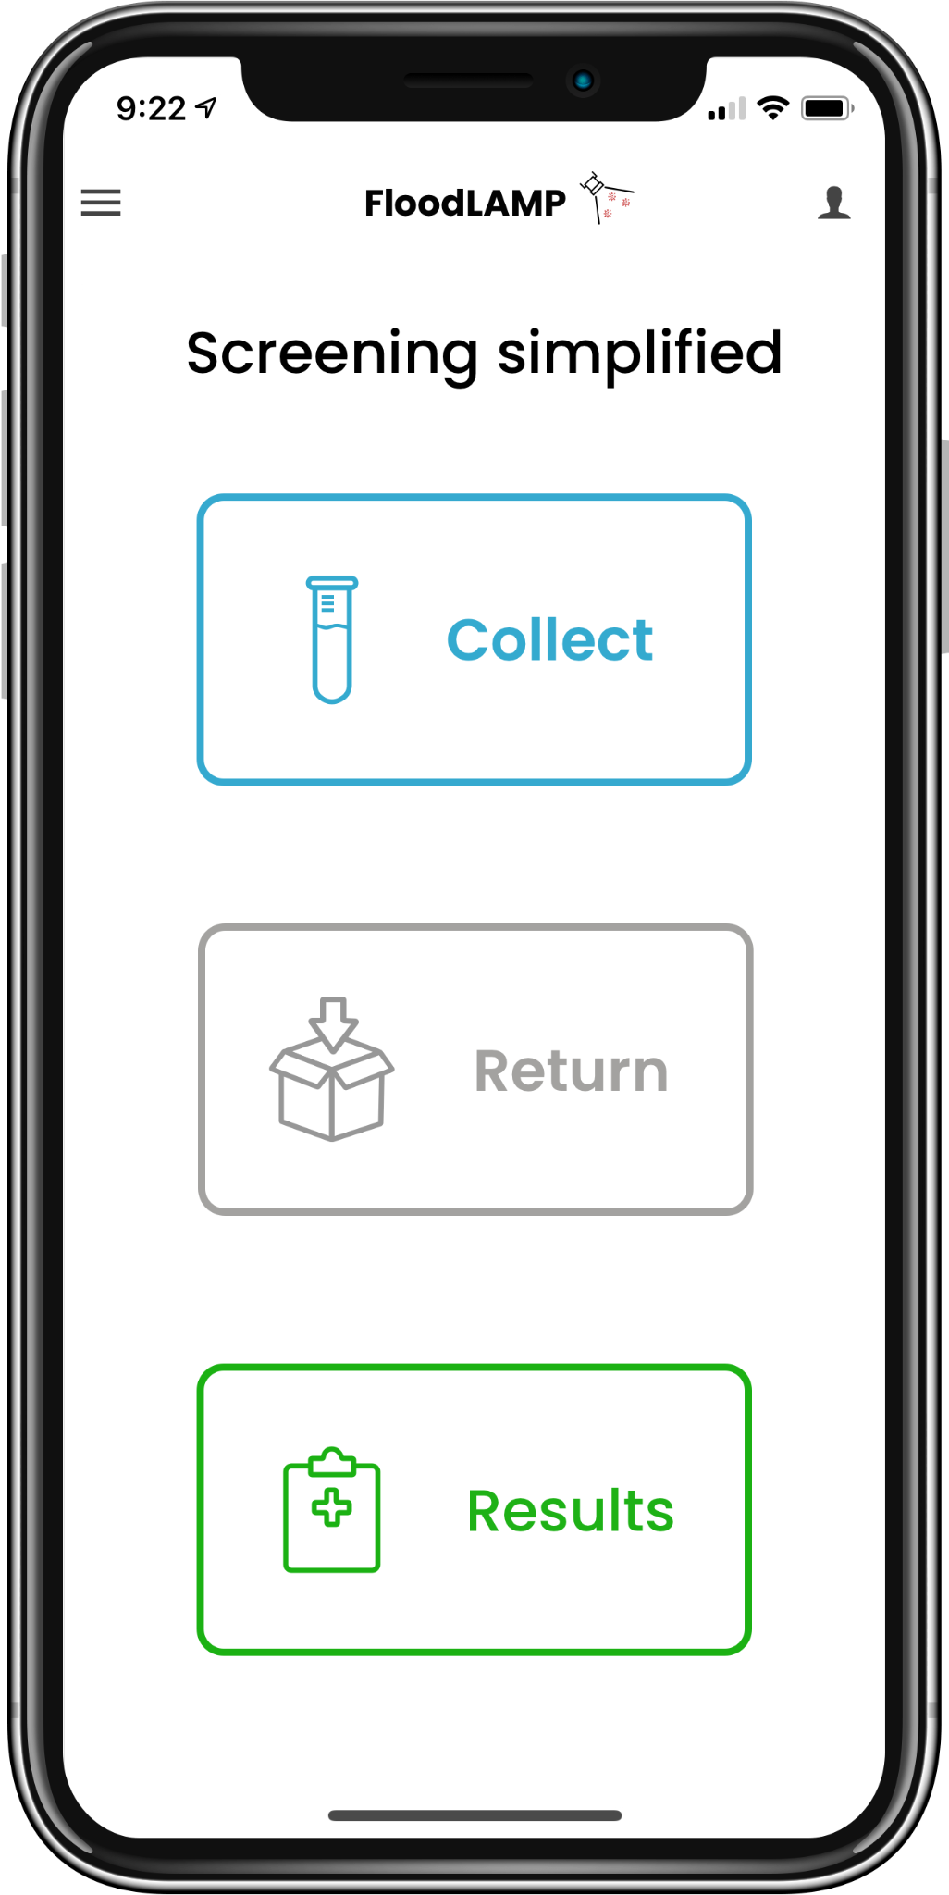
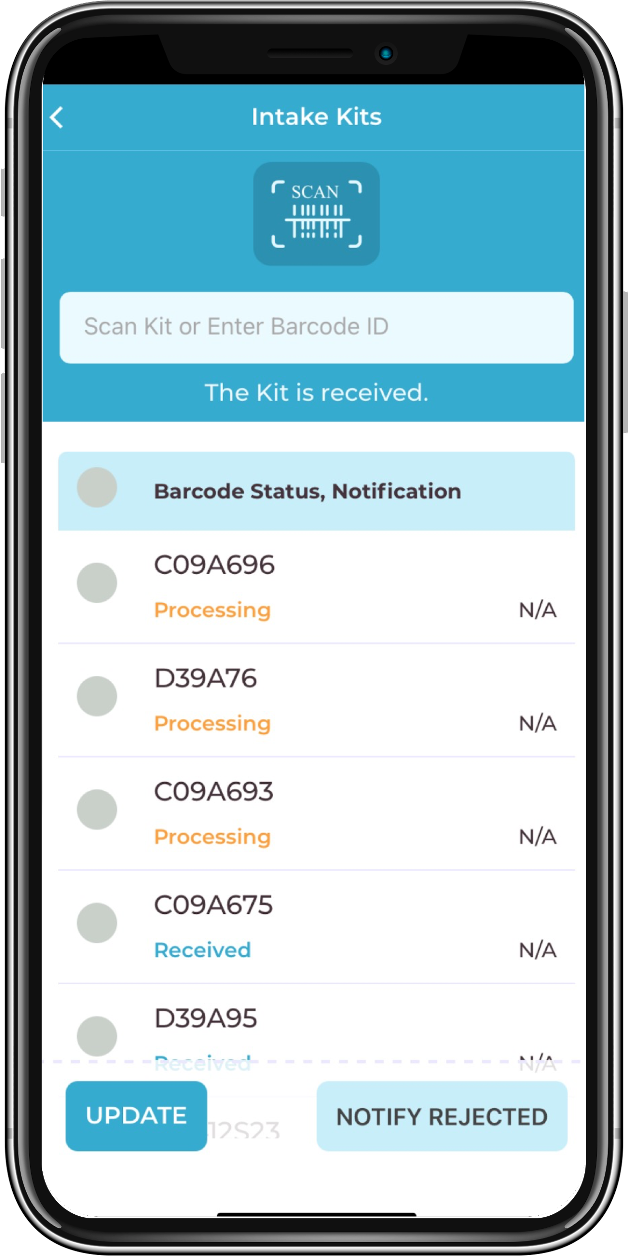
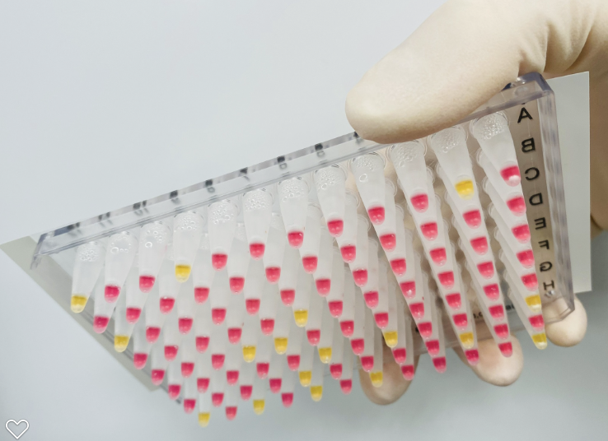
Our Unique Solution
Standalone Components and Fully Integrated Program
Pooled Swab Collection
At-home Family Pooling
Up to 4 nasal swabs per sample tube
Upfront at-home and on-site pooling makes lab processing far more efficient
FloodLAMP Mobile App
Decentralized Accessioning
Supports both self and sponsored collection
Results can be reported directly to participants and administrators
Lab staff and program admin interfaces
FloodLAMP QuickColorTM Test
Molecular Performance
RT-LAMP "PCR-like" molecular amplification
No instruments to run test or analyze results
Low cost and easy to run
Results in 45 minutes with only 15 min hands-on
Turnkey Complete Packages
1000's Samples/Day Anywhere
Everything needed to bringup program from empty room with 3 tables
Comprises calibrated standard equipment, supplies, consumables, and test reagent kits (50+ SKUs, many pre-prepped for ease of use)
Quality System
Streamlined traceability
In development with top QMS consulting group
Covers suppliers, manufacturing, and test processing
Training Program
Remote certification
In development with top learning experience consulting group
Assessment for understanding and compliance
Enables rapid growth while maintaining quality

Slide 8

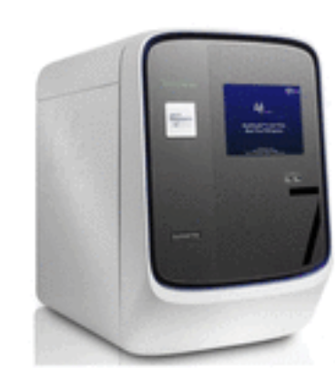
Core Assay Technology
FloodLAMP has fully validated 2 complementary tests that are best-of-breed with EUAs submitted to the FDA. Pooled home collection kit was also submitted for interactive review. The test workflow and collection kit has been designed to expand to other disease targets in the future.
QuickColorTM LAMP Test*
High sensitivity (90%)
Ultra-high throughput
Ideal for serial screening
Uniquely scales without capital intensive instruments
*Licensed from Harvard Medical School (Rabe Cepko - "SARS-CoV-2 detection using isothermal amplification and a rapid, inexpensive protocol for sample inactivation and purification" PNAS 09-29-2020, MGH Clinical Validation Preprint)
Visual Readout
Streamlined Sample Prep
Upfront swab pooling
Highly scalable, integrated processing
Same sample for both tests
EasyPCRTM Test
Very high sensitivity (98%)
Medium throughput (1.5 hrs/94)
Ideal for diagnostics and confirmatory reflex
Standard RT-qPCR instrument

Slide 9
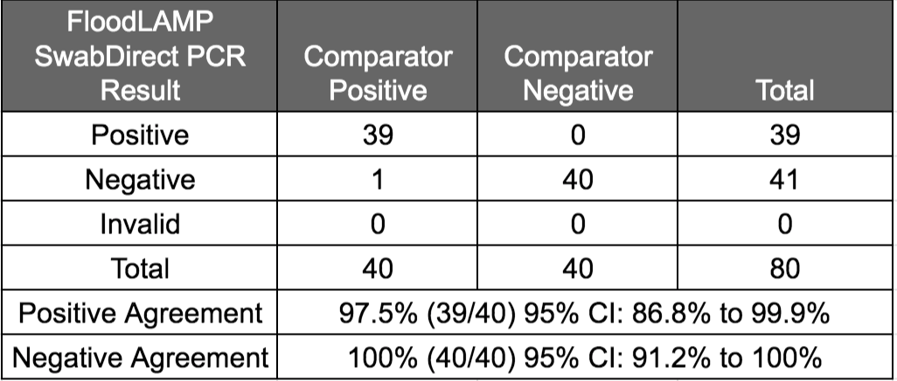
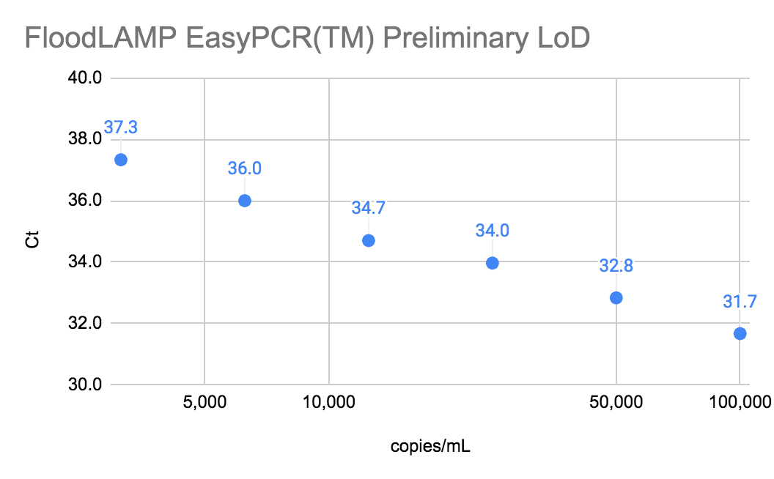
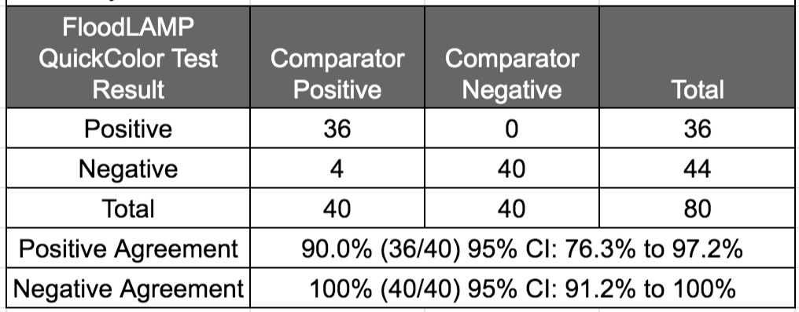
Clinical Evaluation Data
Clinical evaluation performed by the Stanford CLIA Lab, with excellent results and praise on the "really straightforward" protocol.
EasyPCRTM Test
3 copies/µl LoD
98% sensitivity (PPA 39/40)
100% Specificity (40/40)
No false positives
Gamma inactivated cell lysate from BEI spiked into raw clinical negative sample
QuickColorTM LAMP Test
12 copies/µl LoD
90% Sensitivity (PPA 36/40)
Missed positives only high Ct (>36 with direct PCR)
100% Specificity (40/40)
No false positives
Source of Specimens: Stanford COVID-19 Clinical Testing Program
Specimen Type: Anterior Nares Swab in PBS, previously tested and frozen
Comparator Test: Hologic Panther Fusion SARS-CoV-2 Assay and Hologic Panther Aptima SARS-CoV-2 Assay

Slide 10



Program mechanics
EMS/Employer program
Collection site
Collection site
On-site employee pooled collection
Multiple collection points
Courier service to lab (10-30 minutes)
On-site lab
Case study of hundreds of employees screened daily by one tester in 2 hrs
Cost $2 per person
Flexibility for follow up testing of families and contacts
Case study of asymptomatic town manager testing positive, and using FloodLAMP to immediately test his family, picking up 2 asymptomatic positive kids and stopping exposure in their schools
10-30 minute courier
Collection site
Collection site
On-site FloodLAMP lab
Collection site
Collection site

